Slide 1
National Apprenticeship Week
National Apprenticeship Week is coordinated by the National Apprenticeship Service and is designed to celebrate apprenticeships and traineeships and the positive impact they have on individuals, businesses and the wider economy.
Notes:
Students spend 30 secs discussing what they think National Apprenticeship week is

Slide 2
What is an apprenticeship?
An apprenticeship is brilliant if you want to learn on the job, develop new skills, earn some money and get a qualification all at the same time. Your week will be split between working and studying at a college or other learning institution.
There are three levels you can study at:
Intermediate (Level 2)
Advanced Apprenticeship (Level 3)
Higher Apprenticeship (Level 4 and above)

Slide 3
What is an apprenticeship?
There are a range of opportunities available from apprenticeships at large well-known companies like BT, ASOS and the NHS as well as smaller local businesses.
Apprenticeships can last anywhere between one and five years.

Slide 4
Entry requirements
Anyone above the age of 16
Entry requirements are set by the company offering the apprenticeship
Level you can apply for will differ depending on your qualifications
  e.g. five good GCSE grades and good post 16 results can lead to an Advanced or Higher Apprenticeship.

Slide 5
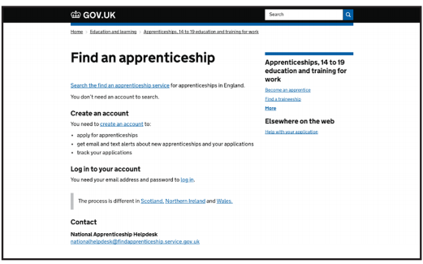
Where can I find the right one?
By setting up an account you will be able to:
Search and apply for the full range of apprenticeships
Save your searches and set up alerts
Apply on-line for jobs that interest you
Go to ‘Find an apprenticeship’ www.gov.uk/apply-apprenticeship

Slide 6
Challenges and benefits
What do you think are the 5 challenges and benefits of becoming an apprentice?
Challenges
Benefits
Notes:
10 mins
Discuss your answers. Did the group identify similar points?
Card sort into challenges and benefits.
Ask for feedback from alumni

Slide 7
What next?
Visit: www.getingofar.gov.uk for more information on the benefits of apprenticeships
Watch videos of real apprentices telling their stories on YouTube, Get In Go Far Facebook and Get In Go Far Instagram
The National Apprenticeship Service can help individuals find an apprenticeship or traineeship. Visit GOV.UK and search ‘Find an apprenticeship’ or ‘Find a traineeship’.
Follow the apprenticeships vacancy twitter feed @AppVacancies
For advice on career choices search online for the National Careers Service
Notes:
We recommend to print for students

Slide 8
How can I find out more?
National Apprenticeship Service (http://nas.apprenticeships.org.uk/) – This is a great website where you can search for opportunities as well as watch videos about current apprentices.
Not Going to Uni (http://www.notgoingtouni.co.uk/) – Have a look at Not Going to Uni to find out about the options available to you if you do not want to go to university – including apprenticeships! There’s a great ‘Be Inspired’ section too where you can find out about different jobs.
All About School Leavers - https://www.allaboutschoolleavers.co.uk/
Plotr (www.plotr.co.uk) – Plotr is a one-stop-shop for everything you need to know about career options. There’s lots of information about apprenticeships, interesting articles to inspire you, and lots more.
Student Ladder (www.studentladder.co.uk) – Check out Student Ladder for a range of opportunities including ‘School Leaver Programmes’, which are also known as Higher Apprenticeships.
Notes:
We recommend to print for students

