Slide 1
Entrepreneurial skills
Traditionally ‘entrepreneurs’ are people who set up their own businesses, taking risking in the hope of being successful or making money. But being entrepreneurial is much more than that. Even if you don’t plan to launch your own enterprise, it’s still a key skill for the world of work.
Entrepreneurial skills include being ambitious, innovative, and spotting opportunities. People who are entrepreneurial are driven by positivity and the desire to make changes and grow.
Here are some activities you can do to become more entrepreneurial:
Plan a fundraiser in your community e.g. a school social event to raise money for a new IT equipment and ask local businesses to provide raffle prizes
Research what sorts of services are needed in your area and if you could fill any of these gaps e.g. are there lots of overgrown gardens you could offer to tidy up? Are there younger students who are in need of homework help via video call? You could make leaflets to promote your services!
Design a household item to help families live in a more eco-friendly way and pitch it (more information on p3)

Slide 2
What do alumni say about entrepreneurial skills?
‘The more you give to your employer in hard work and commitment, the more they will in turn give you back in experience and opportunity. In the future you need as many contacts as you can to push yourself forward, especially in the world of entrepreneurship, so spread your wings as wide as you can.’ Claire, Bottisham Village College
“The most challenging aspect of my job is staying organised. Running one business is difficult enough, but to run three as I do you must be as organised as possible. Use and manage your time effectively and apply yourself at every stage with a positive attitude. Remember, attitude above all!” - David, Hall Cross Academy
“Now I design webpages and logos as a freelancer and I am selling my fabric designs online. I started my own e-shop on Etsy. As I’d learnt about sustainability in fashion at college, I tried to do something about the waste. I made cushions made of recycled wool. I contacted all the companies that made wool mattresses, to see if they had any left overs to make the cushions.” - Helena, Newham College
“It’s always important to do things outside of your comfort zone. For example, if you know that you have some free time over summer, look for local opportunities (such as volunteering or working) where you can challenge yourself and do something different, as opposed to just chilling at home or with friends the whole time. Getting used to this will boost your confidence and help you achieve more in the future.” - Rowan, Upper Shirley High School

Slide 3
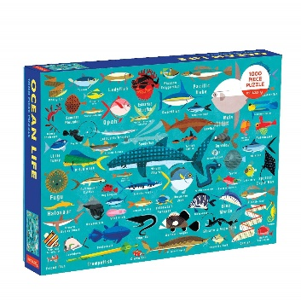
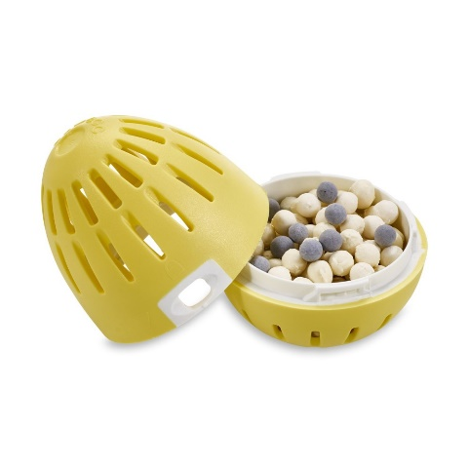
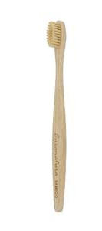
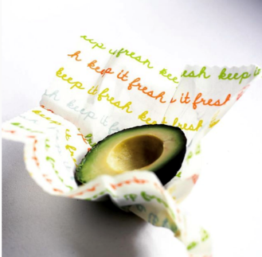
Using your skills: your task
Design a household item to help families live in a more eco-friendly way.
Here are some real examples:
A children’s puzzle
made from recycled
ocean plastic
A laundry egg which allows people to wash their clothes without using chemicals
A reusable cling film alternative made from cotton and plant waxes
A biodegradable toothbrush made from bamboo

Slide 4
Your product
Draw and/or describe your household item

Slide 5
Creating a business plan
Who is your target audience?
Where will you sell your product?
How much will it cost to make your product? How much profit will you make?
What is your Unique Selling Point (USP)? What makes your product special?

Slide 6

Pitching your product
Imagine you’re trying to persuade an investor to support your product financially.
To do this, you might need to write a ‘pitch’, which is a short presentation outlining your product and explaining why it will succeed.
Use the structure on the next slide to write a pitch for your product.

Slide 7
Pitch structure
Introduce yourself and what you’re presenting your audience
Problem - outline the problem that your product is solving
3. Solution - explain how your product solves this problem. What are its features? What is it’s Unique Selling Point which makes it better than the competition?
Talk through your business plan
Thank you and a punchy ended – sum up why they should invest!

