Slide 1
Creative Skills
Creativity can come in many different forms, and can be a skill that will really help you in the world of work.
Creativity is the use of imagination to think of original and inventive ideas.
You can be creative in many ways; whether this is through design or art, writing, or through how you solve problems in interesting ways. This is a skill that you’ll be developing in every day life.
Here are some ways that you can get creative:
- Using Canva to jazz up your CV
- Making facemasks for vulnerable people
- Making something crafty to sell to raise money for charities supporting those in lockdown,
- Design poster template and create one of your future self (see the task on p.3)

Slide 2
What do alumni say about creative skills?
The good news about becoming a fiction author is that you don’t need any formal qualifications at all, although Creative Writing is an option at both degree and postgraduate level. My English degree certainly helped me, however, providing me with a broad literary education and invaluable critical skills. I’d say the most common advice given to aspiring writers is simply to read. Read, read, read. The more you read the better your own writing will be. - Jenny, Children's Author, Ratton School
I am continuously learning about new techniques and digital applications that help me in my designing process. I am gaining more knowledge in different areas such as online marketing, management, production etc. - Helena, Graphic Designer, Newham College
I recommend for any creative courses to find a course where you are able to take an internship. An internship is one of the best decisions I ever made and it was a really turning point in my attitude to work and opened the door to a lot of other opportunities which wouldn't have existed if I didn't take an internship. - Hannah, Product Design Consultant, Thomas Aveling School

Slide 3
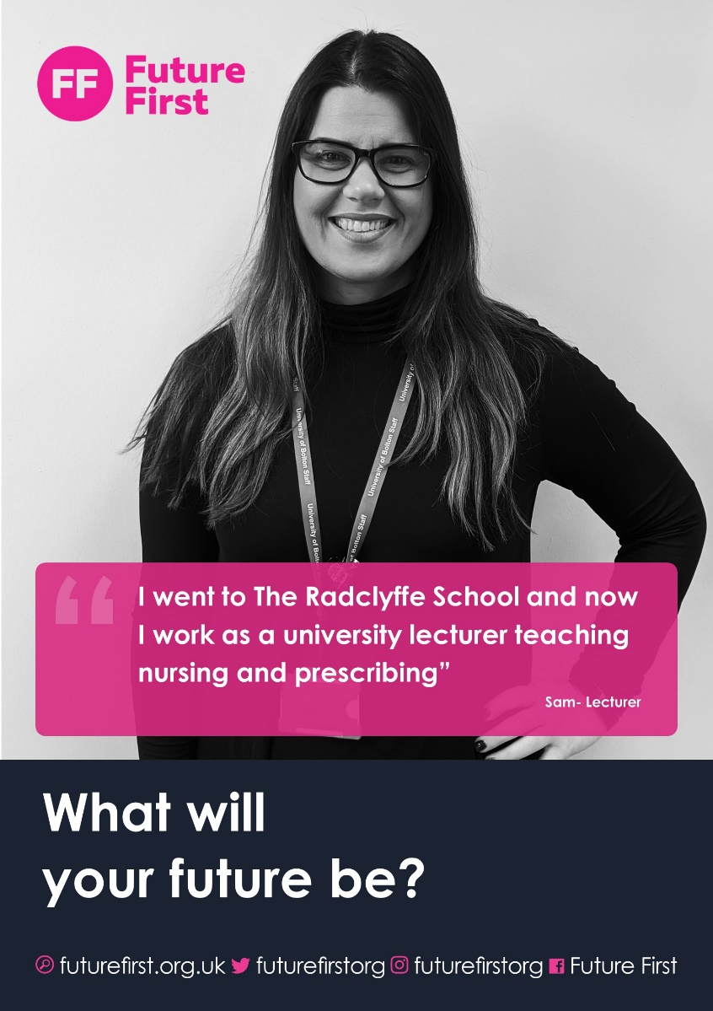
Designing a Poster
Here’s a task that will help you get creative!
This is an example of a Future First poster- we use them to show off the different things that volunteers do in their jobs.
Each poster includes a picture of someone at work, and a short bit of information about what they do in their career.
We want you to create a poster of yourself in your dream job, but with a twist!
Can you create a new poster design?

Slide 4
Guidance
You can design this poster however you like, using PowerPoint, Canva, Paint or any other application that you’d like to create your poster.
If you’re not able to do that, you can draw your poster on A4 poster and take a photograph of the picture.
Canva has poster templates to give you a bit of inspiration, and you can find that here.
Remember to include a picture of you in your dream job and a ‘tagline’ about what you do in your job
Email your completed posters to info@futurefirst.org.uk

